Slide 1
CHAPTER 19
Oxidative Phosphorylation II
Xiao-Wei Chen, Ph.D.
xiaowei_chen@pku.edu.cn

Slide 2
Outline of today’s lecture
Review of oxidative phosphorylation
Regulation of oxidative phosphorylation
Other functions of mitochondrion

Slide 3
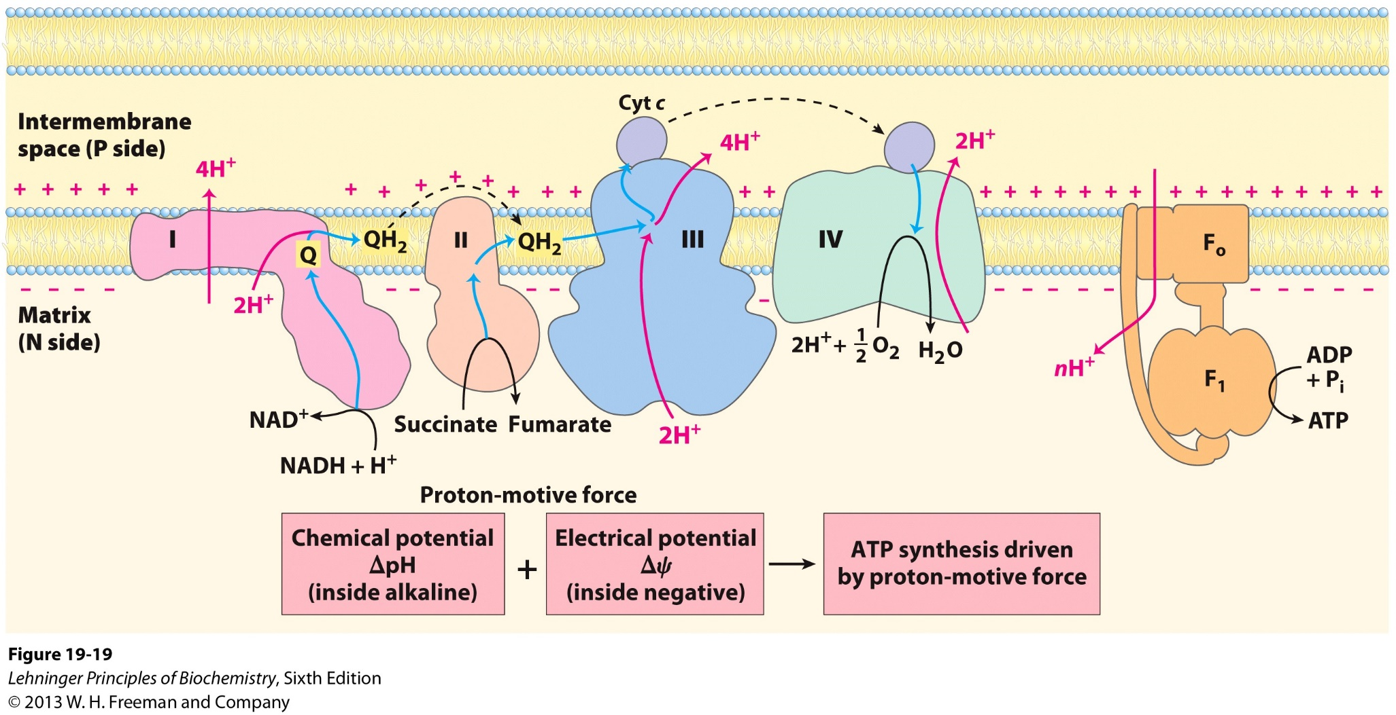
The chemiosmotic model: ATP synthesis driven by the proton gradient across inner mitochondrial membrane

Slide 4
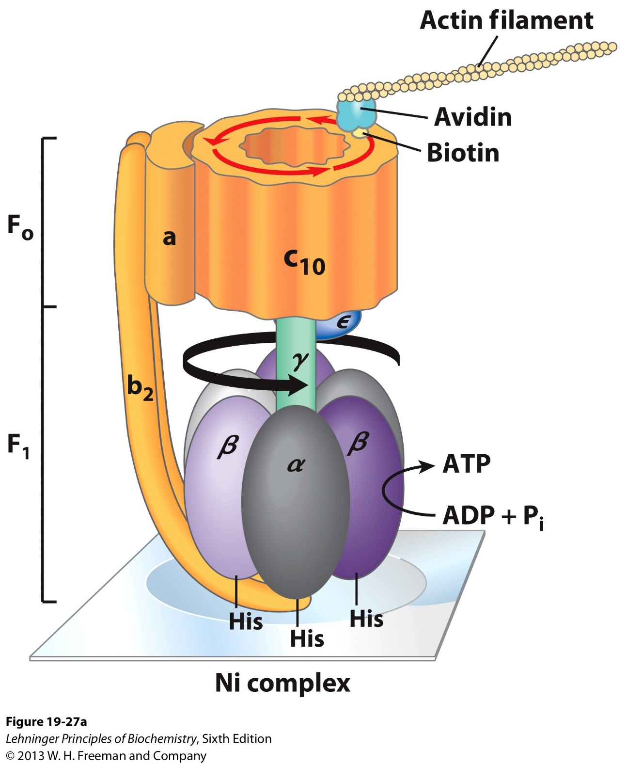
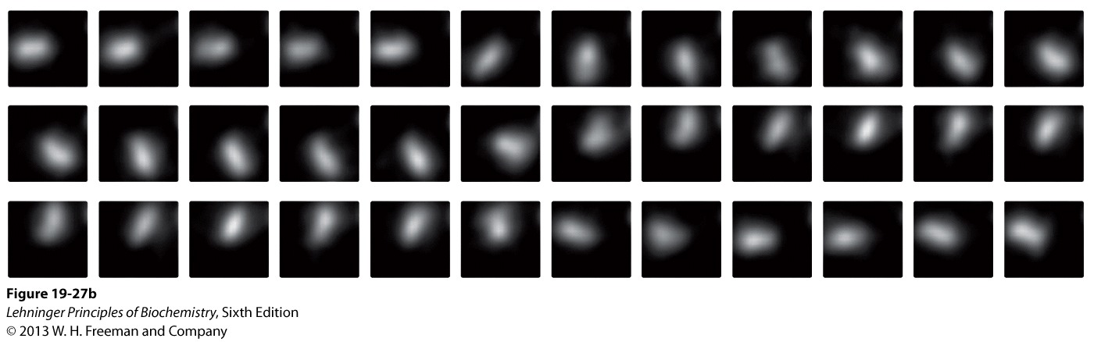
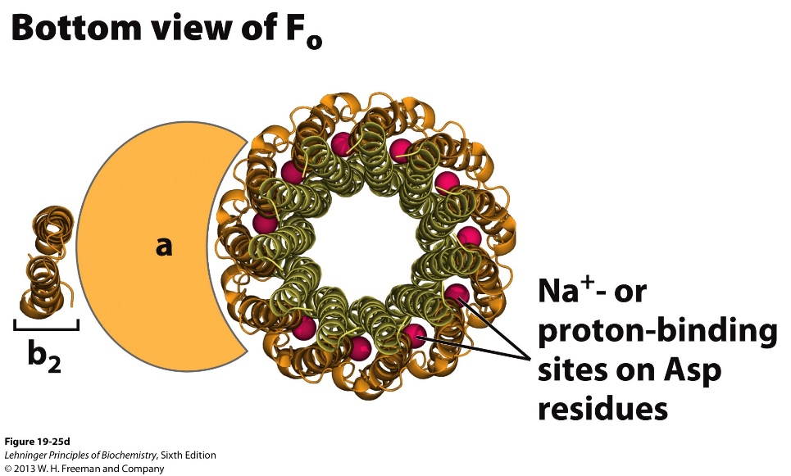
Experiments to visualize the rotation of the ATP synthase

Slide 5
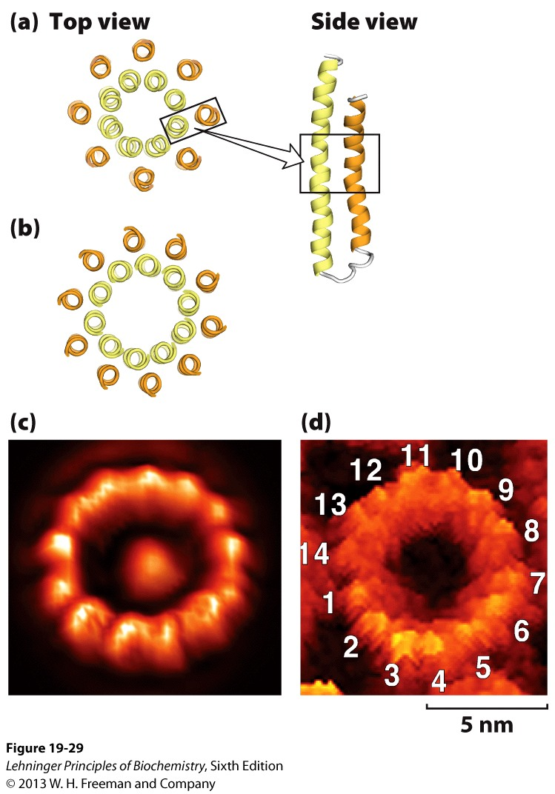
How many protons are needed to produce 1 ATP?
A full circle of rotation = 3 ATP
A full circle = number (N) of subunits in the C ring
N = 10 – 14 (take 12 for average)
Therefore, ~4 protons are needed to produce 1 ATP
Bovine: 8
Yeast: 10

Slide 6
How many ATP does one NADH generate?
What about one FADH₂
How many ATP does one glucose generate?

Slide 7
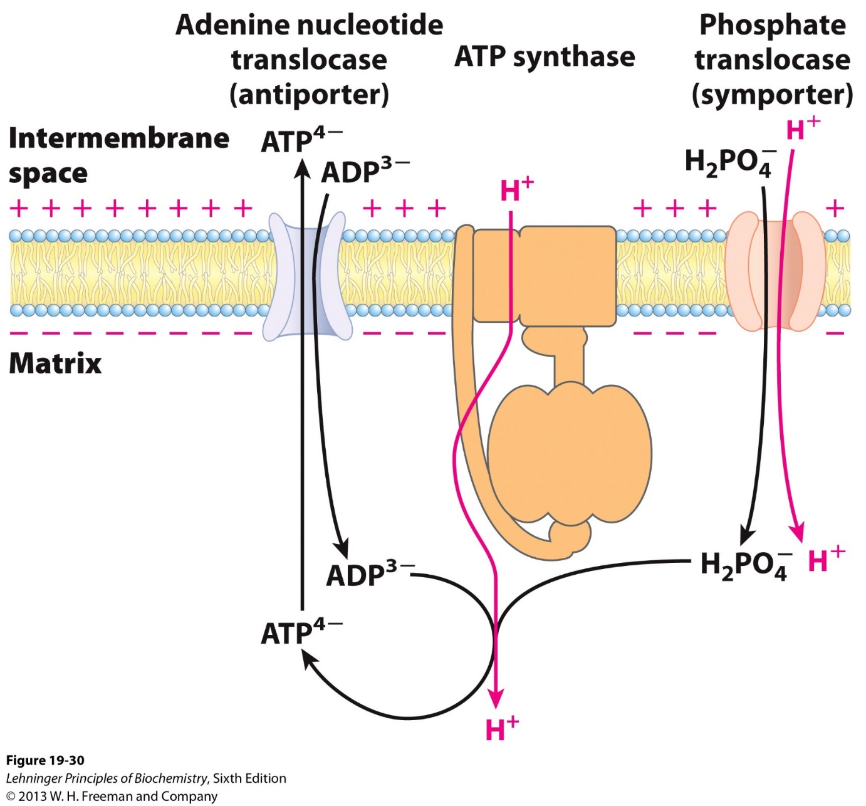
The adenine nucleotide translocase and phosphate translocase transport ATP and Pi across IMM
Proton concentration favors transport of ATP⁴⁻ to the IMS (positively charged)
Pi transport into the matrix consumes some potential force from the proton gradient.

Slide 8
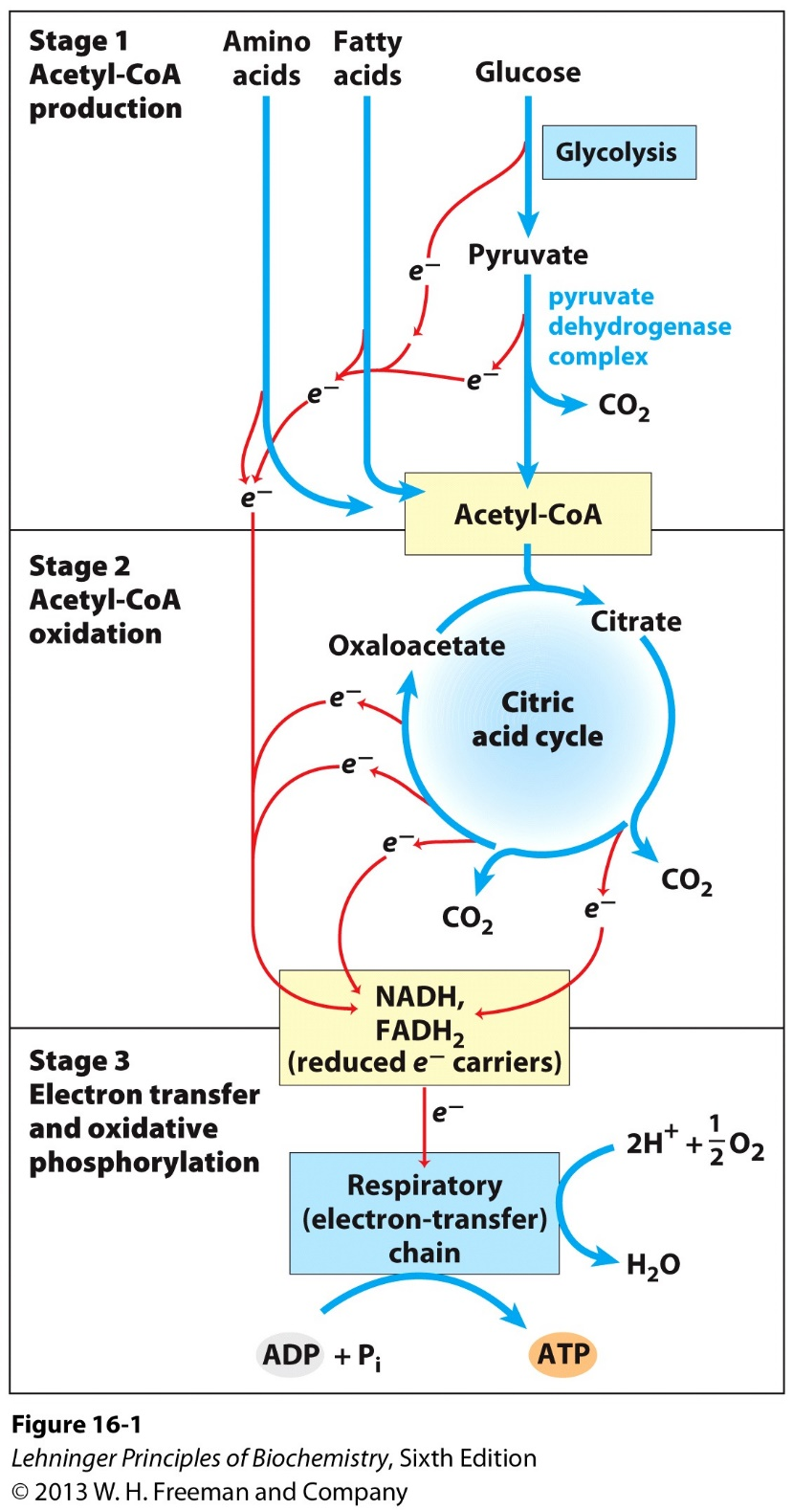
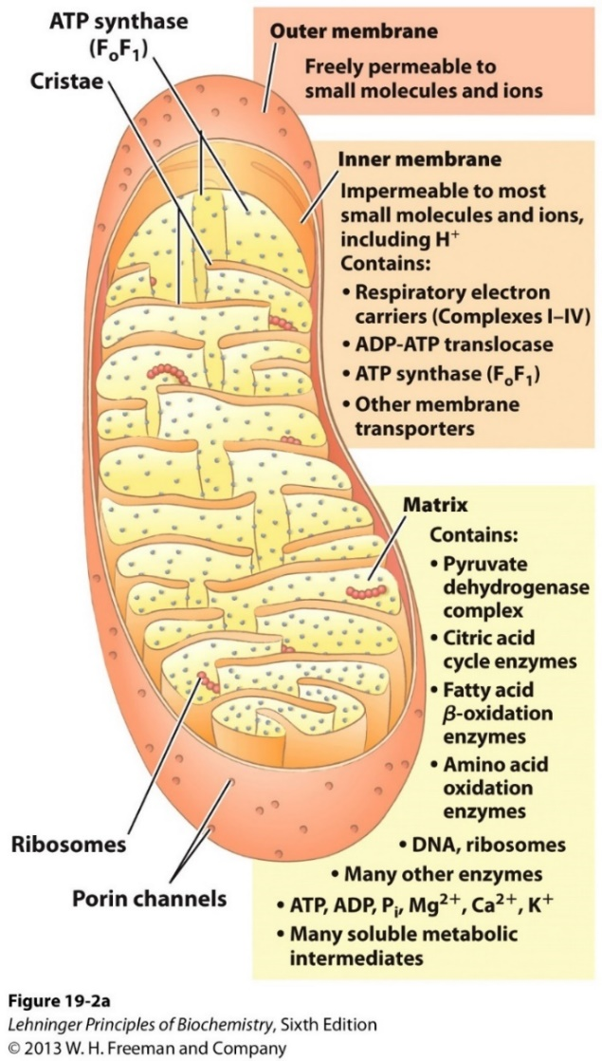
How many ATP does one glucose generate in aerobic conditions?
Cytosol
Glycolysis
Mito Matrix
TCA
Respiration

Slide 9
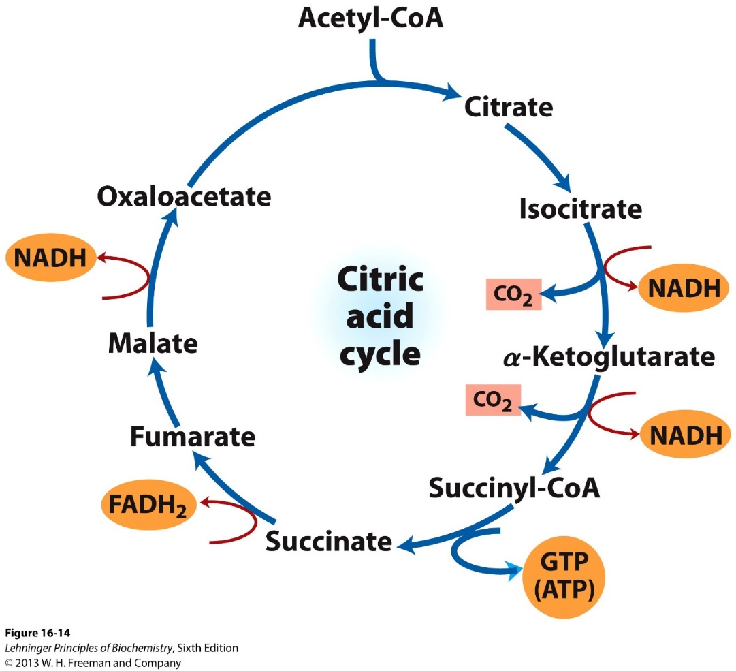
Pyruvate dehydrogenation and Acetyl-CoA oxidation in mitochondrion matrix
Pyruvate
Pyruvate dehydrogenation
1 NADH = 2.5 ATP
Acetyl-CoA oxidation
3 NADH = 7.5 ATP
1 FADH₂ = 1.5 ATP
1 GTP = 1 ATP
Two pyruvates produced from one glucose
NADH

Slide 10
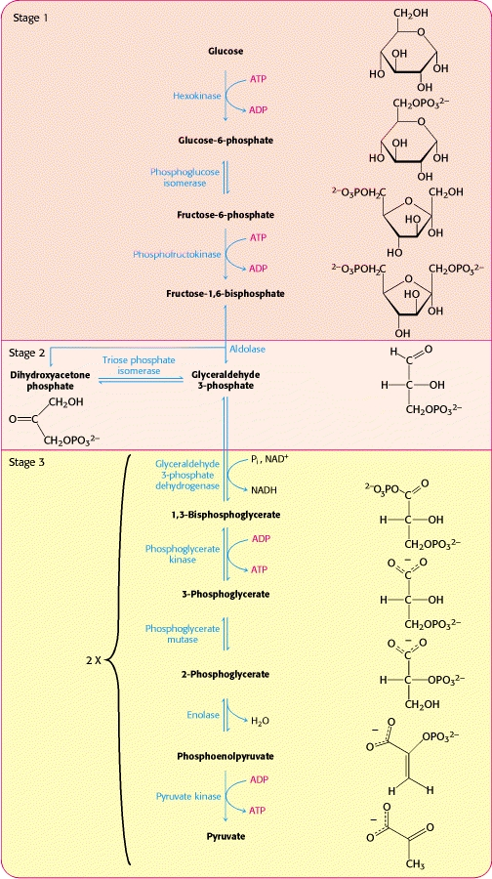
Glycolysis in the cytosol
produces 2 pyruvates, 2 NADH, and 2 ATP
NADH cannot pass IMM (Inner Mitochondrion Membrane).

Slide 11
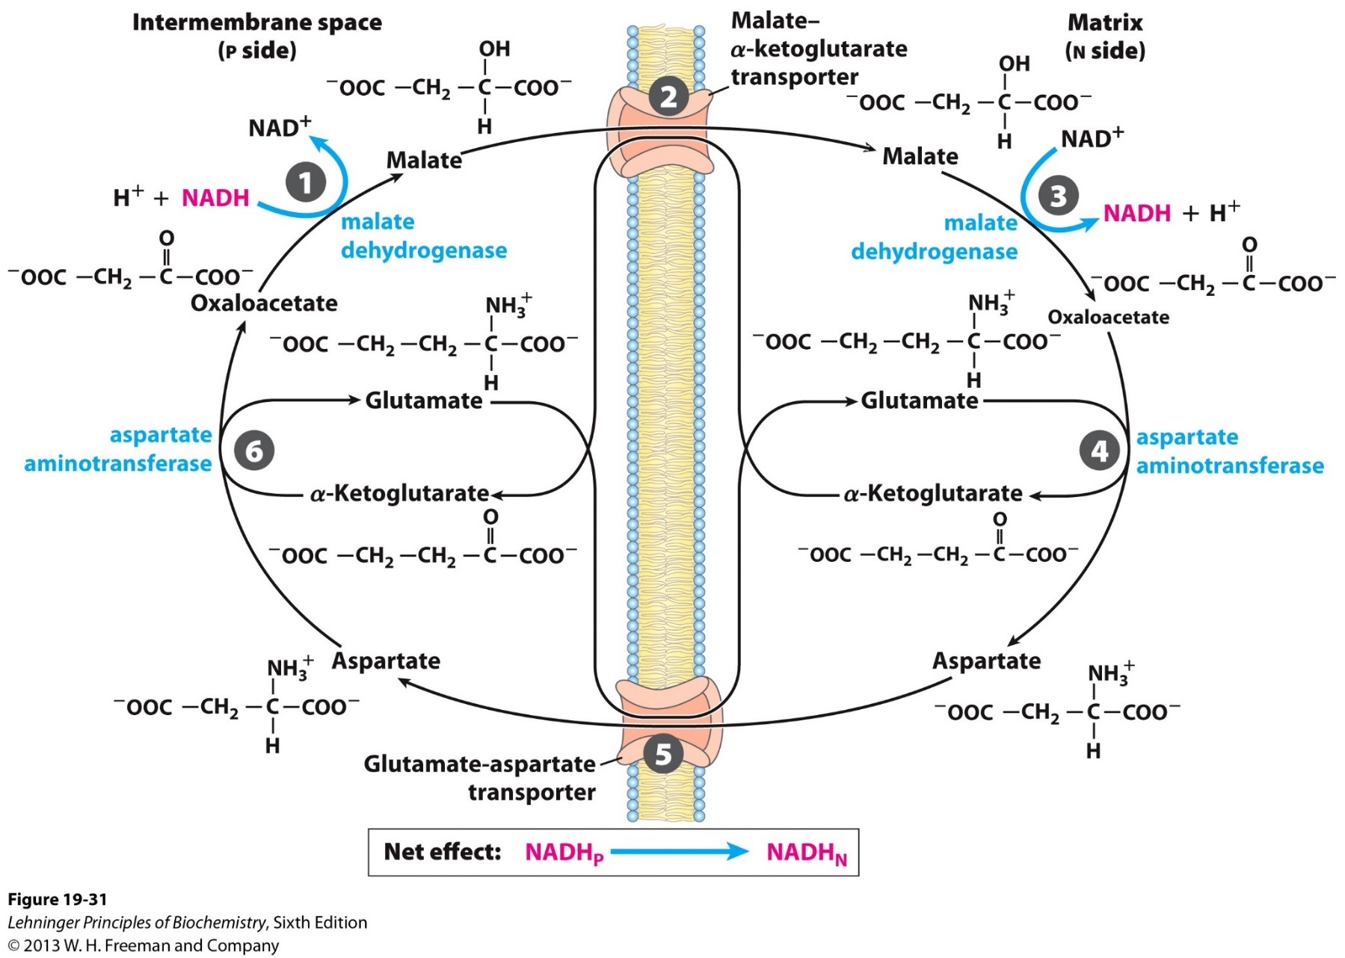
The Malate-Aspartate shuttle mechanism
Cytosol
Mitochondria

Slide 12
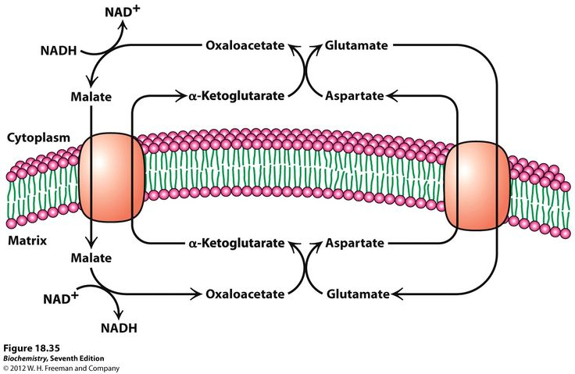
The Malate-Aspartate shuttle mechanism
1 NADH (cytosol) = 1 NADH (mito) = 2.5 ATP

Slide 13
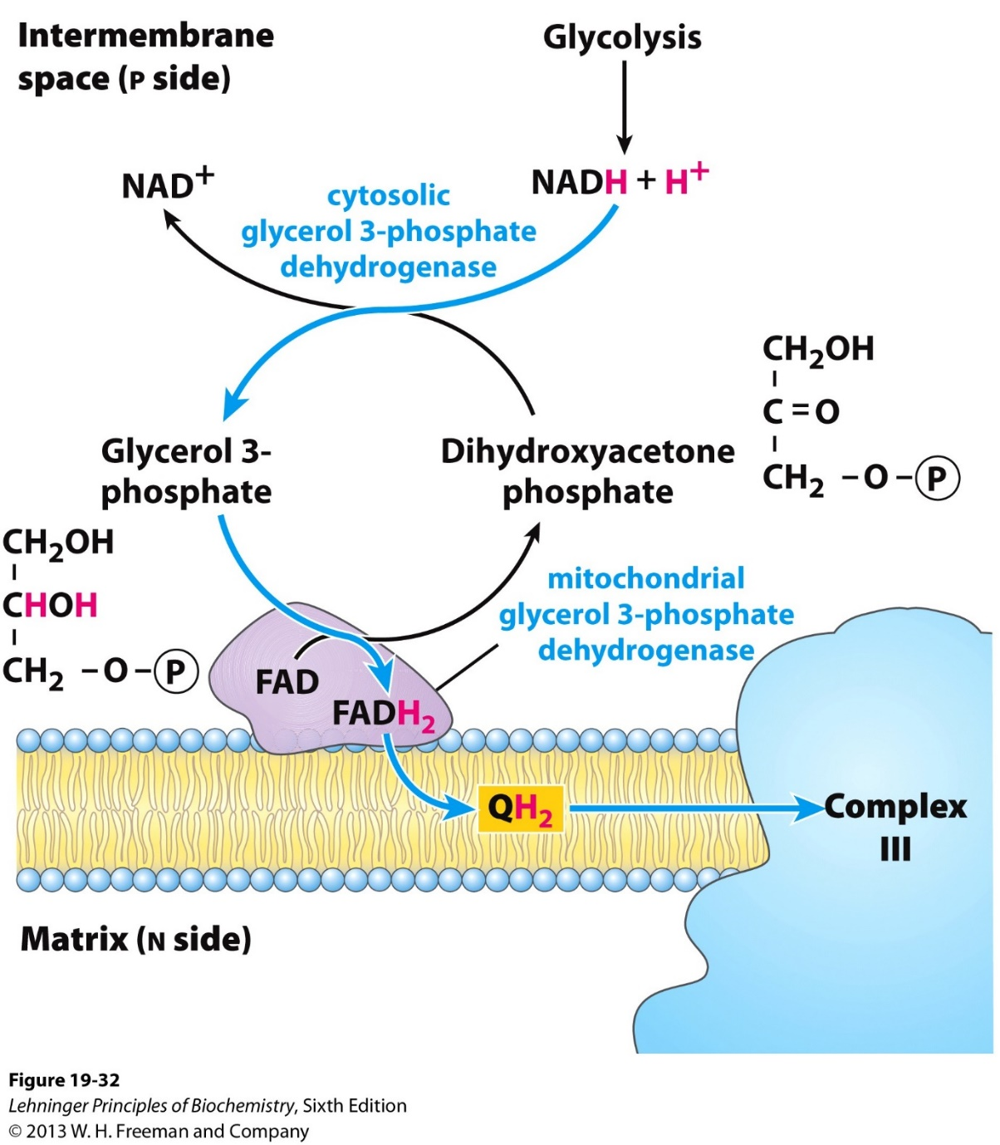
The glycerol 3-phosphate shuttle mechanism
Primarily in muscle and in brain, to rapidly regenerate NAD+, favoring glycolysis.
Uses the mitochondrial G3P dehydrogenase.
Electrons transferred to the complex III, bypassing the complex I, therefore = 1.5 ATP

Slide 14
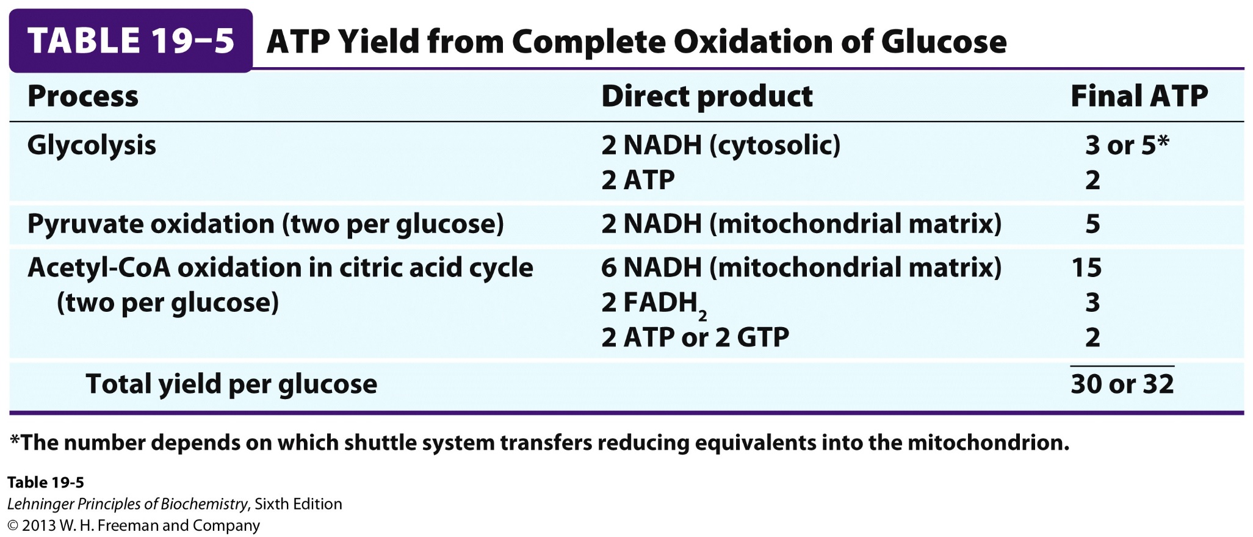
ATP yield from aerobic metabolism of one glucose

Slide 15
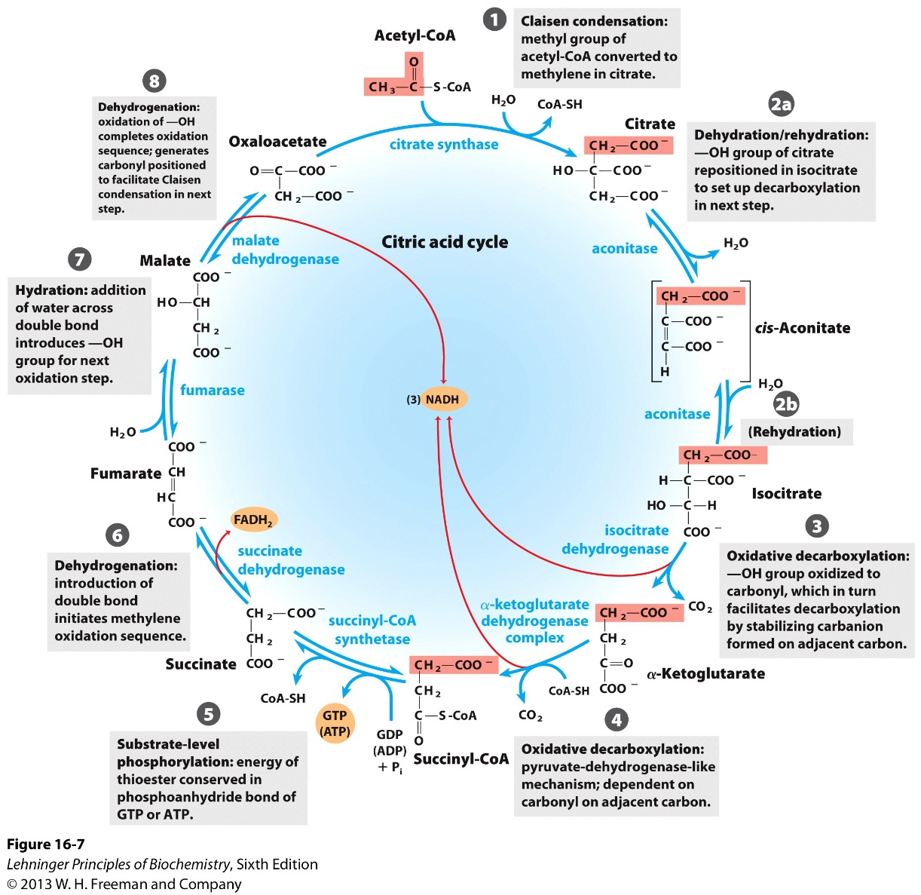
Deficiencies in TCA cycle enzymes
Rare case of inborn metabolic disorders have been identified with mutations in:
Fumarase
Succinate dehydrogenase
α-ketoglutarate dehydrogenase complex
How could patients/cells survive with these deficiencies?

Slide 16
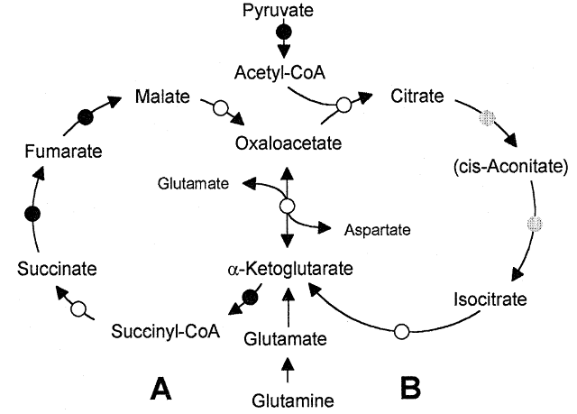
Mini-cycles of TCA reactions could bypass some enzymes

Slide 17
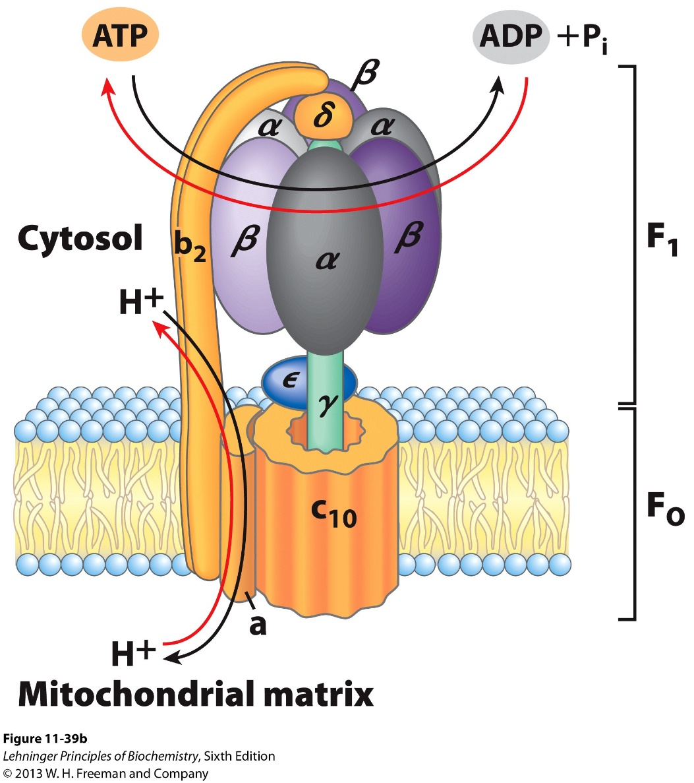
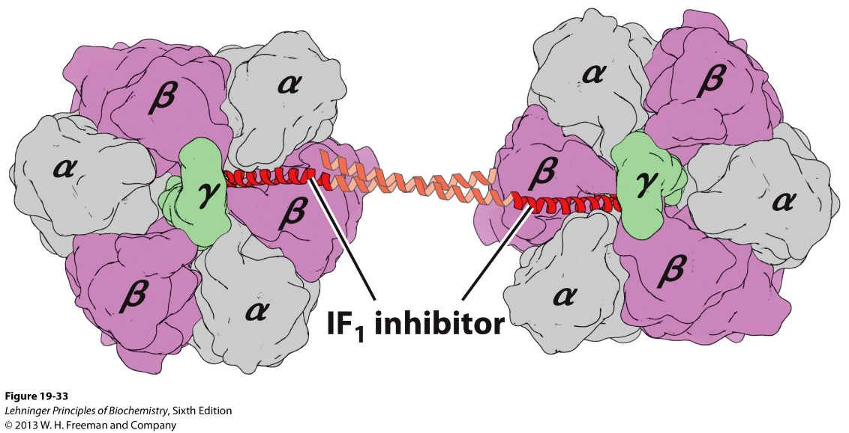
IF₁ prevents ATP hydrolysis by the ATP synthase when O₂ is depleted ( in a heart attack or stroke)
IF₁ (Inhibitor of F₁) functions as a dimer. Its formation is promoted in acidic environment (more glycolysis), preventing a drastic drop of [ATP].

Slide 18
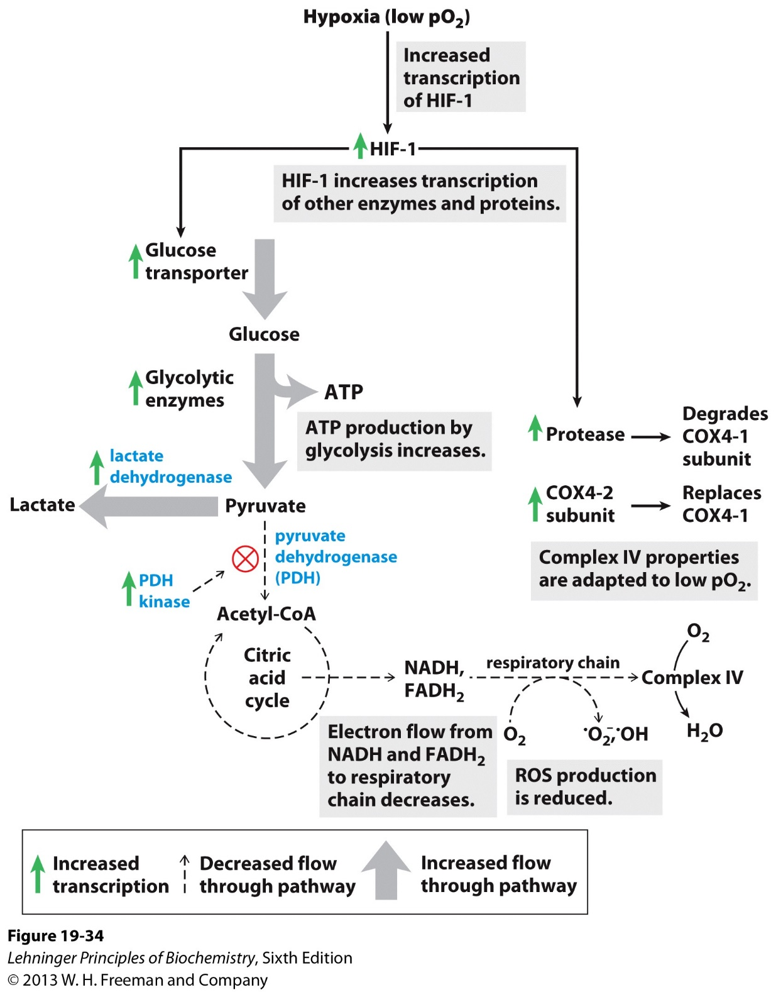
The transcription factor HIF1 coordinate hypoxia response to regulate oxidative metabolism
Upregulate glucose uptake
Glycolysis and fermentation
Inhibits PDH
Remodels ETC (Complex IV)

Slide 19
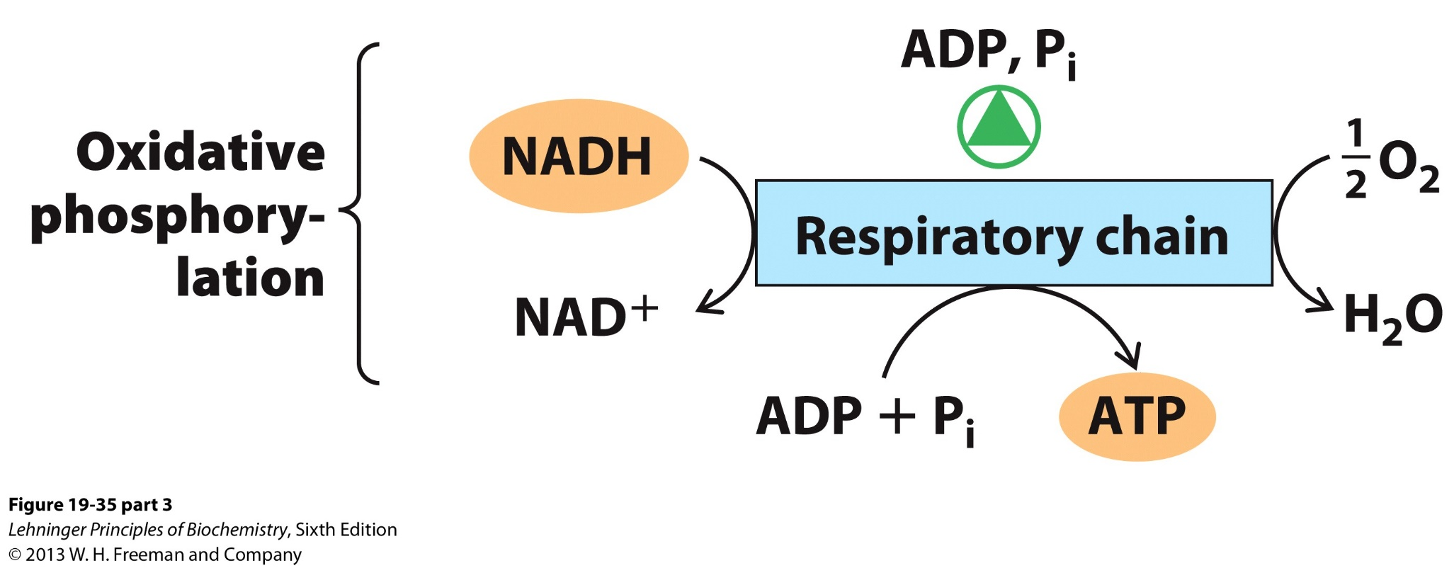
ADP and Pi increase the rate of electron transfer and oxidative phosphorylation

Slide 20
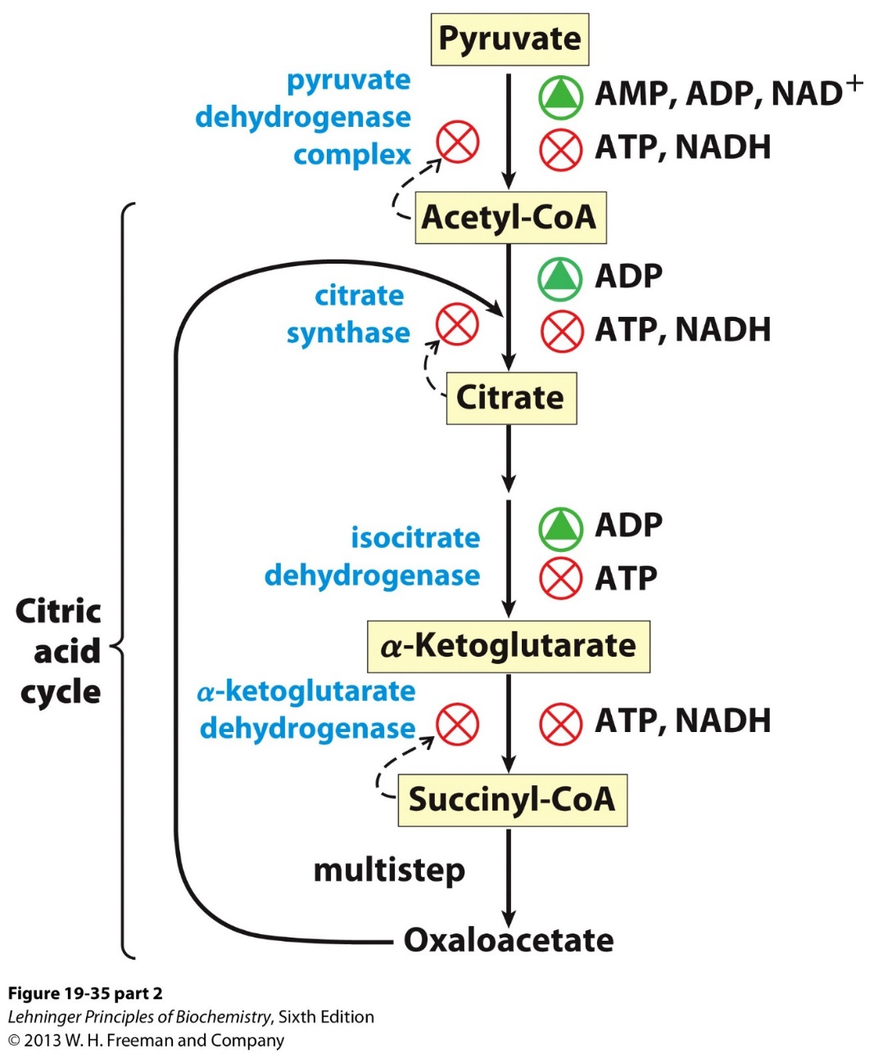
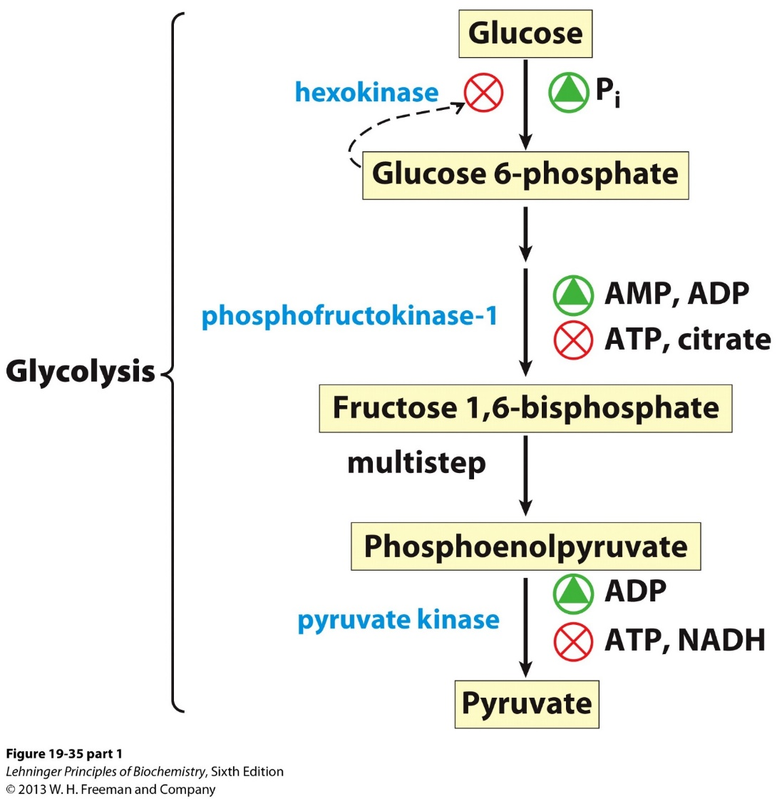
Interlock of ATP production processes

Slide 21
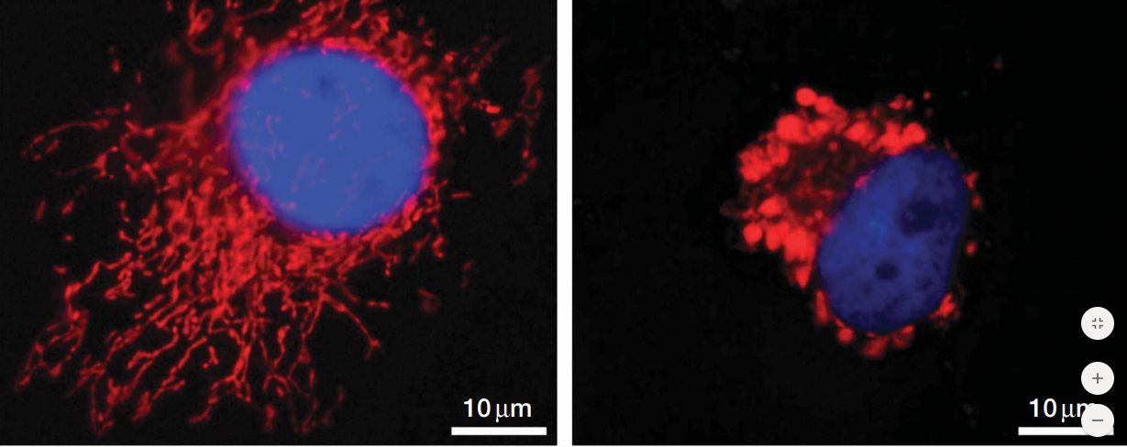
Dynamic changes in mitochondria morphology is coupled with energy metabolism
Filamentous
More oxidative
Granular
Less oxidative

Slide 22
Other functions of the mitochondrion related to oxidative phosphorylation
Thermogenesis
Steroid synthesis
Apoptosis (programed cell death)
Mitochondrion and human diseases

Slide 23



Slide 24
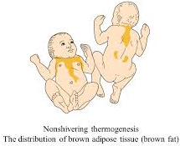
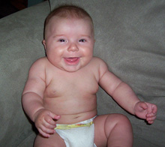
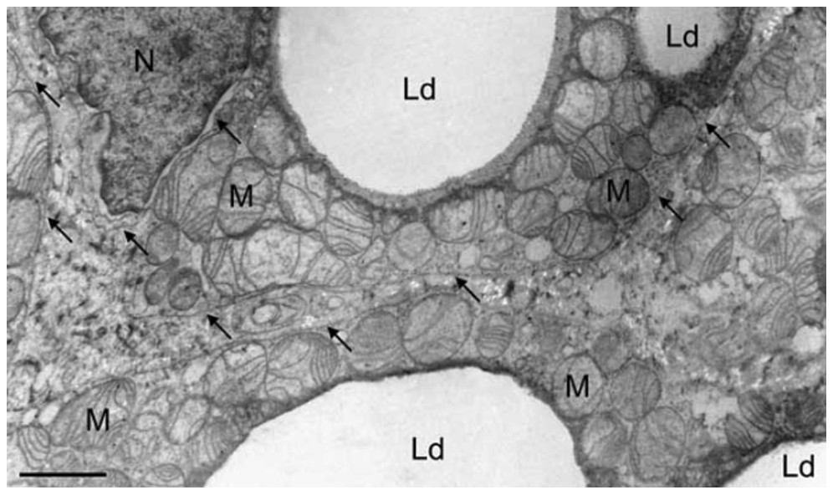
Non-shivering thermogenesis in brown adipose tissue (enriched with mitochondrion)

Slide 25
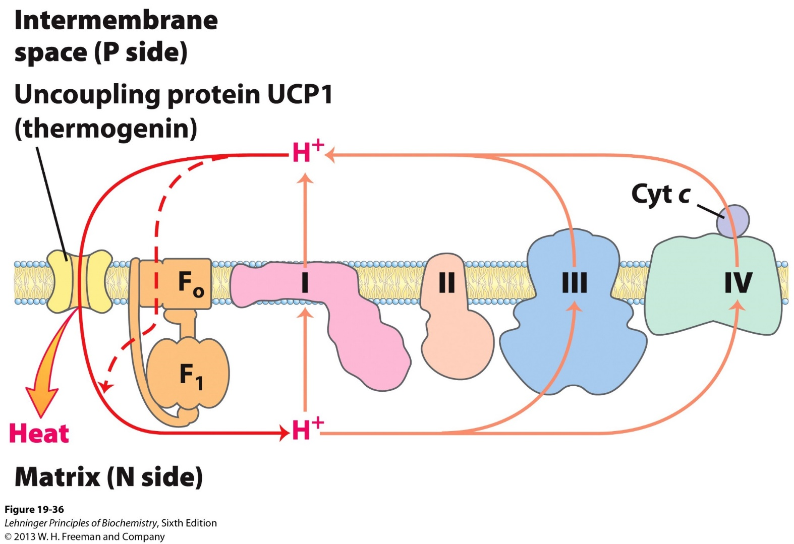
UCP1 uncouples electron transfer and ATP synthesis to produce heat
UCP1: a trans-membrane proton “channel”
Highly expressed in brown adipose tissues.

Slide 26
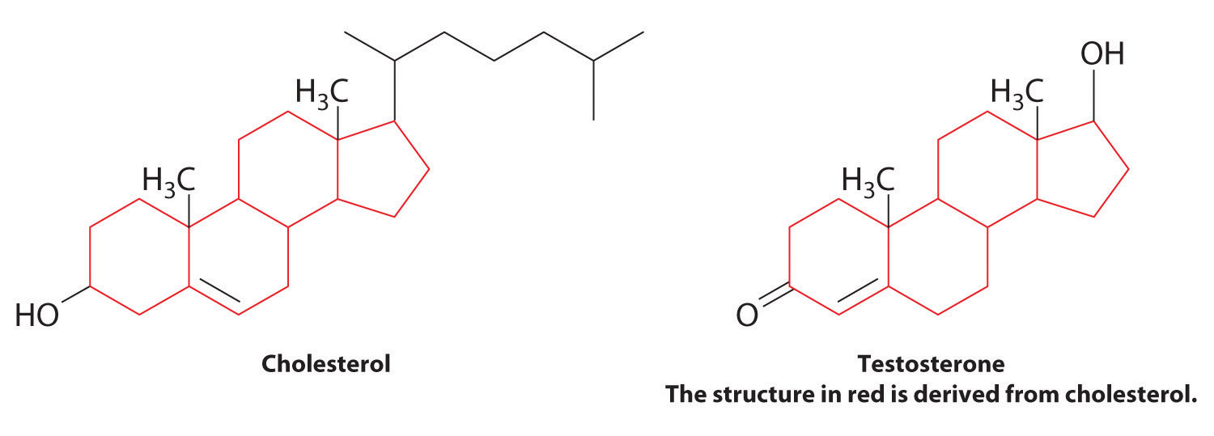
Steroid hormones are often produced from cholesterol, involving a hydroxylation reaction.

Slide 27
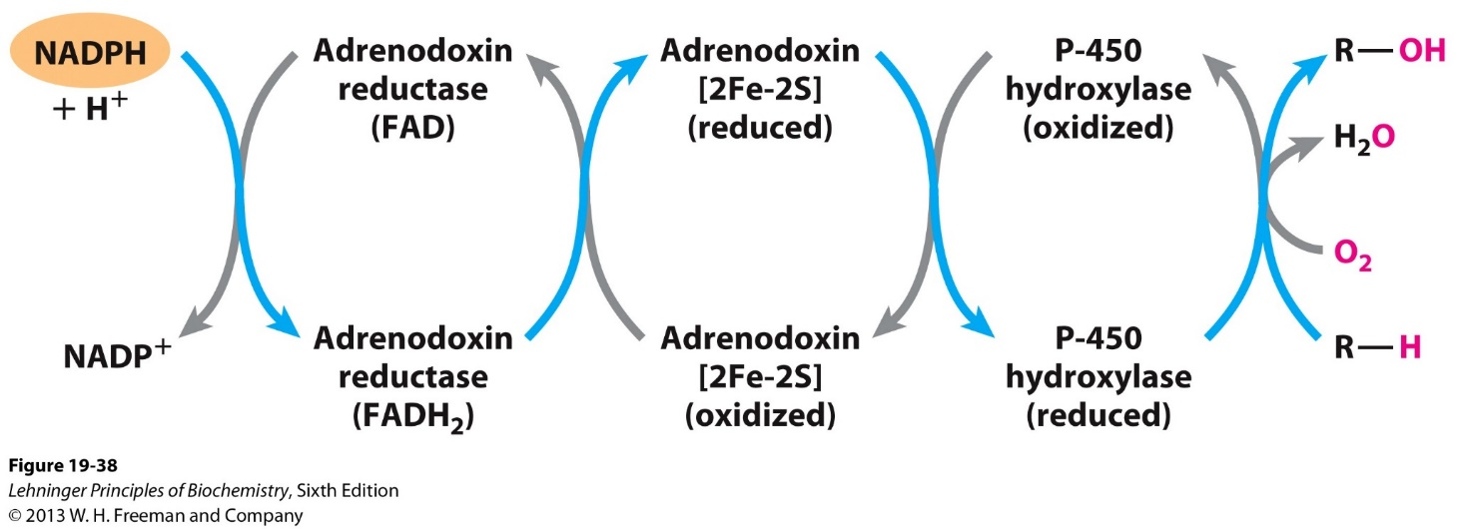
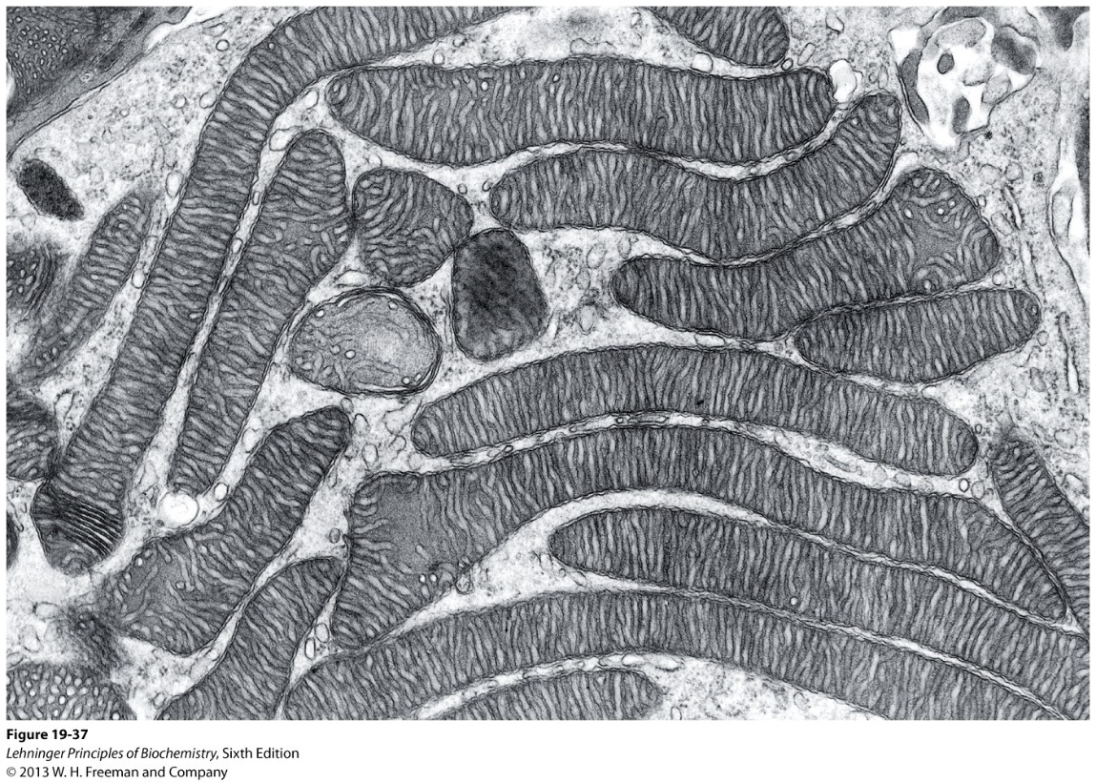
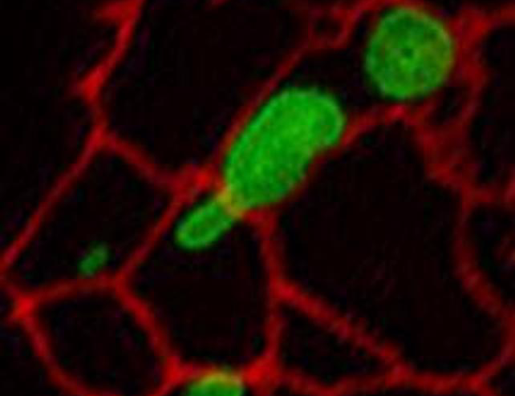
Hydroxylation via mitochondrial P-450
Red: ER
Green: Mitochondria

Slide 28
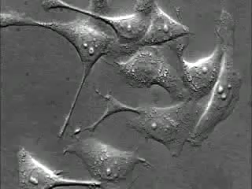
Apoptosis, or programed cell death
https://www.youtube.com/watch?v=rs1Je-8Y3Po

Slide 29
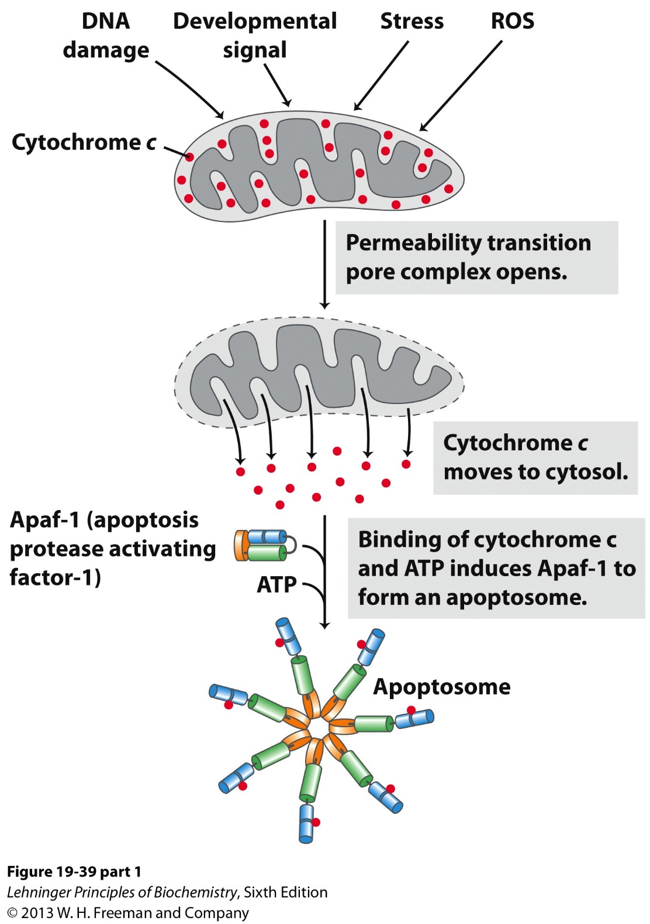
Cytochrome C release and activation of Apaf-1 initiates the intrinsic pathway of apoptosis

Slide 30
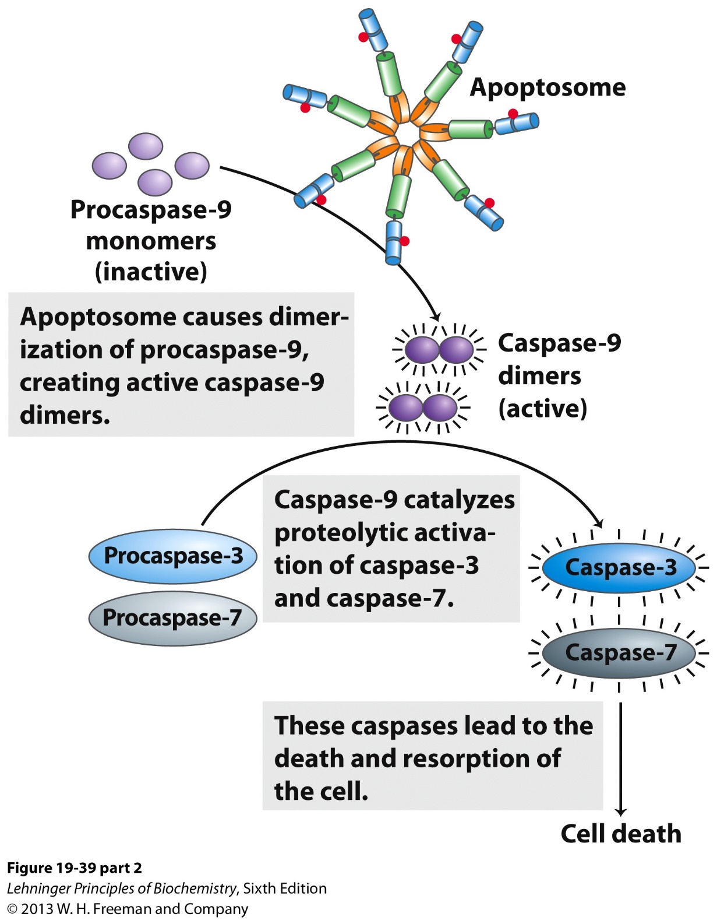
Activation of Caspase cascades propagates cell death signaling

Slide 31
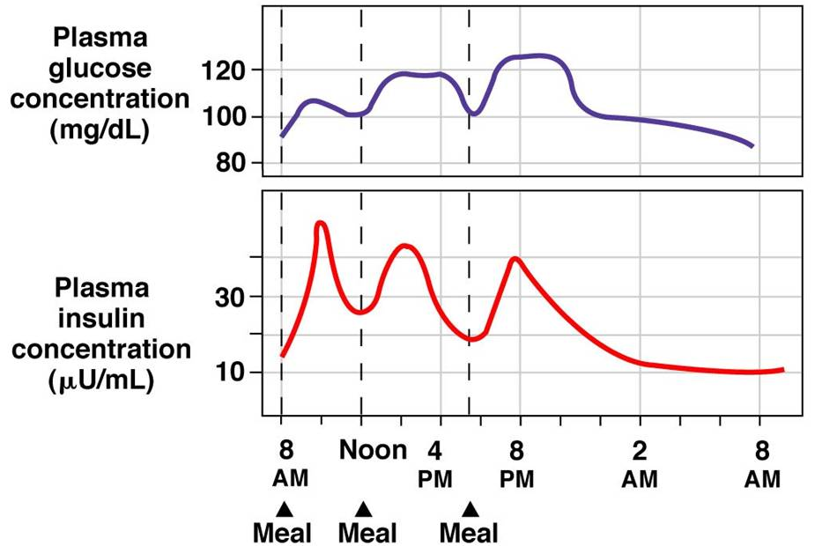
Blood glucose level

Slide 32
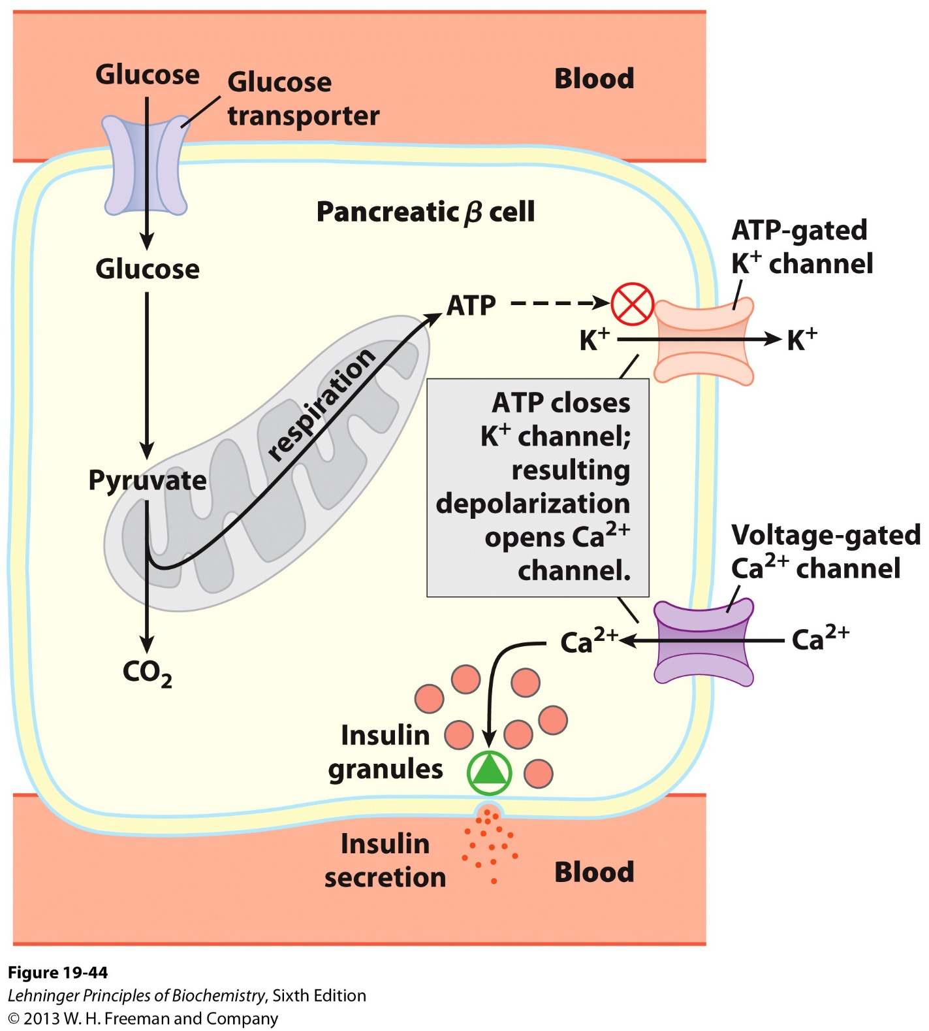
Energy dependent control of insulin secretion from pancreatic beta cells
Mutation of glucokinase leads to rare form of diabetes (MODY), as do defects in the mitochondrial respiration chain.

